Slide 1
ScreenChomp
Kailey Metcalfe

Slide 2
What is ScreenChomp?
ScreenChomp is an interactive app that can be used both inside and outside of the classroom. It allows for students to complete their own work, and to interact with other students, and even the teacher if struggling on what they are supposed to do.
This app allows for students to upload different homework via their Dropbox (an account must be set up) and work on it piece by piece, and mark it up using the markers and interactive white board.

Slide 3
How to Access ScreenChomp
Users must have access to an iPad or computer that apps can be downloaded from (Apple Products)
Access Apple’s App store and search ScreenChomp (it is a free app)
Download the app, and it will appear on your tablets home screen.

Slide 4
Privacy Settings
The app will ask for your birth month and age upon opening the app for the first time
Giving any personal information is completely voluntary, however, if the corporation (TechSmith) deems they need your information, they have the rights to access that information through the use of many parties.
Any students or users under the age of thirteen must have parental consent
If the app is being used through the classroom, parental consent must also be signed if the teacher and students will be using the live chat, and sharing their information to other users

Slide 5
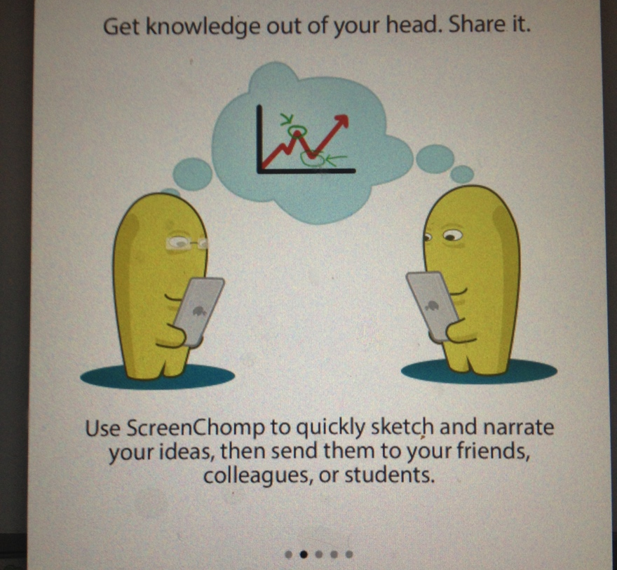
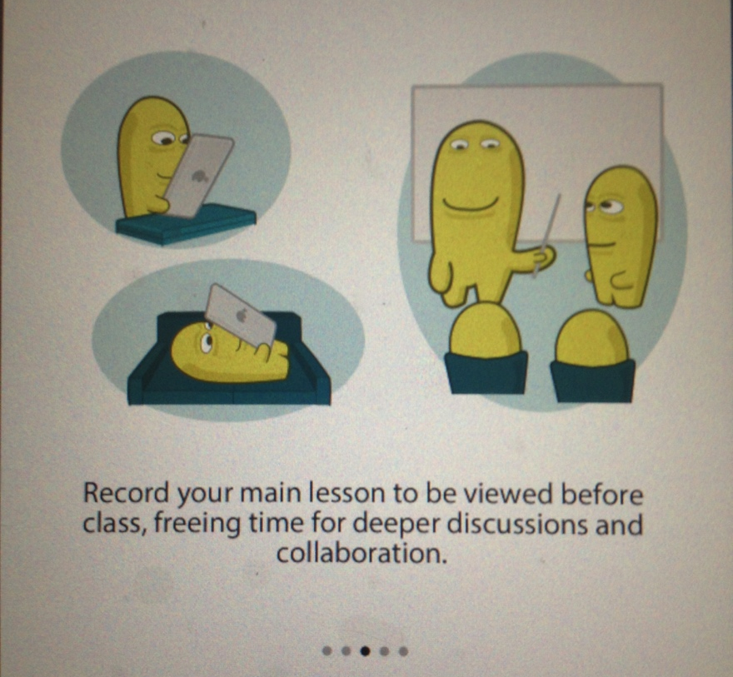
Using the App

Slide 6
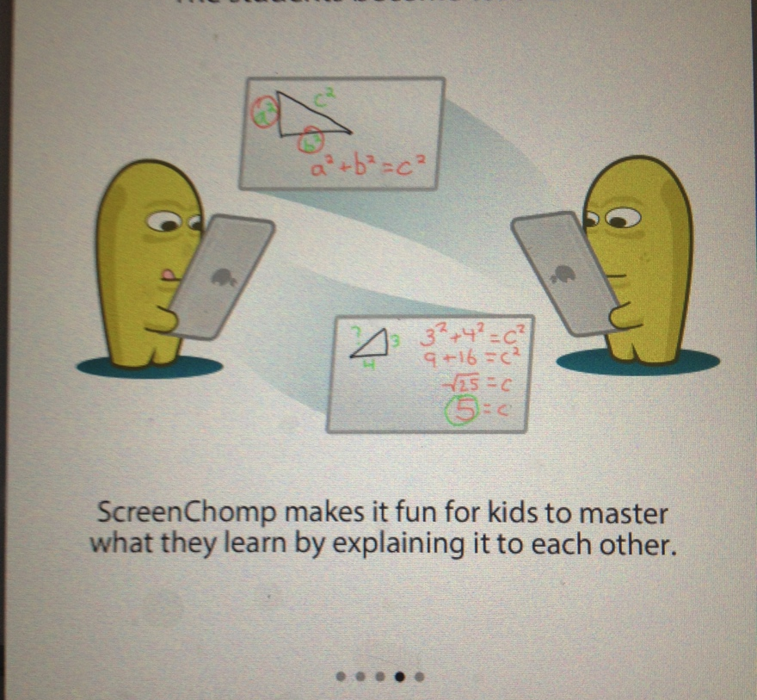
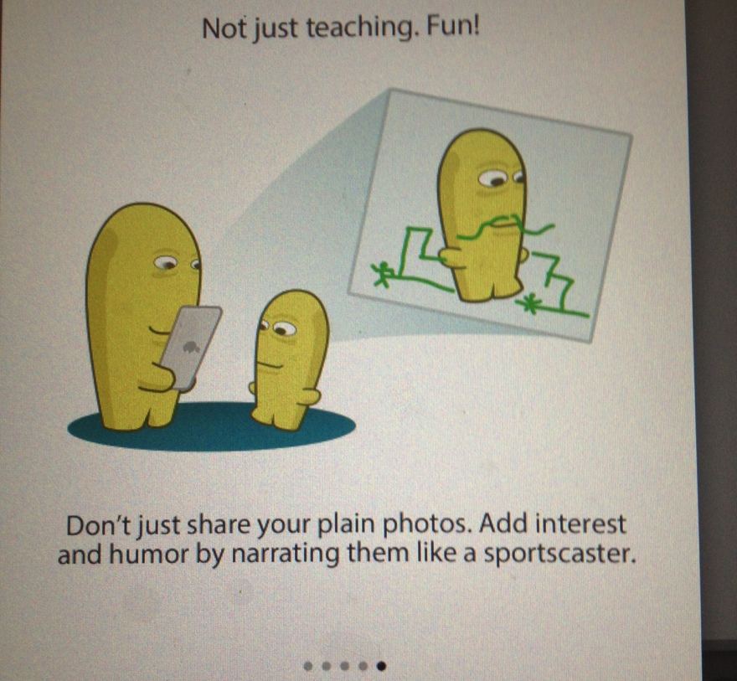
Using the App

Slide 7
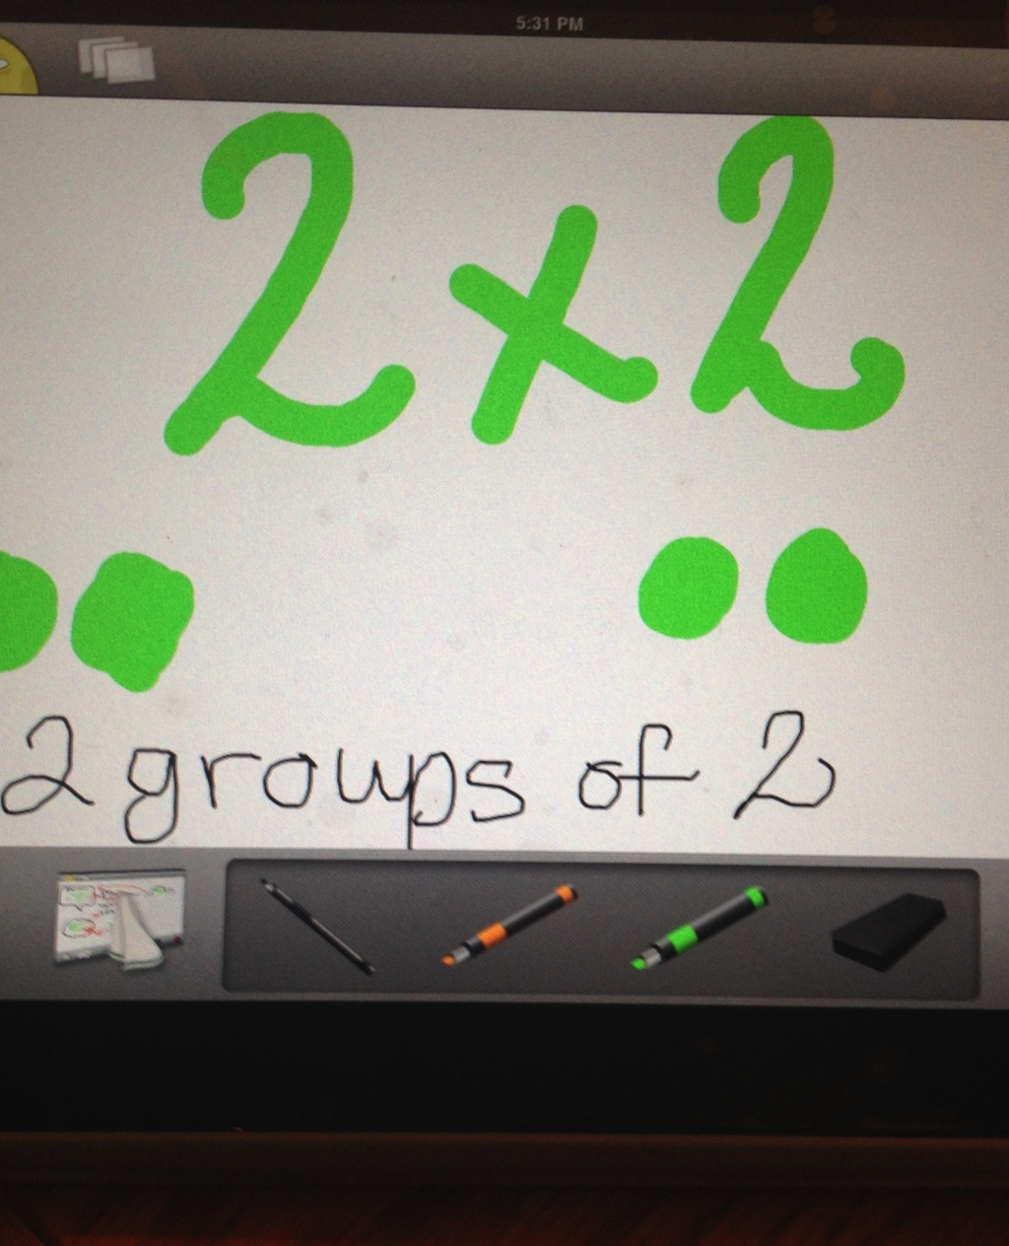
Features of the App
This app contains an interactive whiteboard that allows the student to practice work on, and when confused can share the URL with other students through different social media sites.
If other students, or the teacher sees the URL shared, they can send a video back to the student and describe to them what to do.

Slide 8
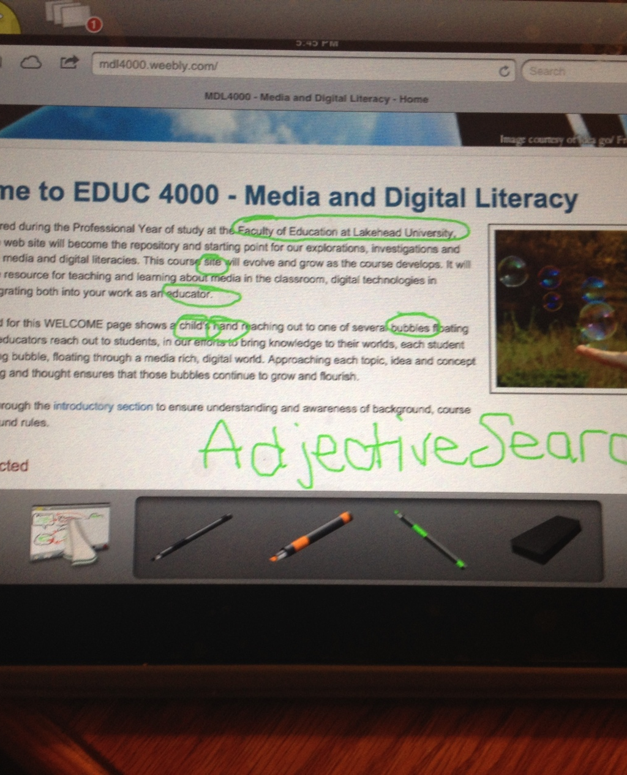
Features of the App
Students can even insert screen shots of websites, or homework accessed through their DropBox and write on it or circle important information.
Any finished or unfinished work can be saved to the Cloud or added back to DropBox.

Slide 9

Benefits for Teacher and Student

Slide 10
Reasons to Use As A Teacher
Allows teacher to interact outside of class with those students who may be struggling with a specific assignment
Allows teacher to provide feedback to student through the app (creating a video or audio recording through the app)
Allows the teacher to create tutorials for students on particular assignments or homework help
Incorporates media and technology in and out of the classroom
Great differentiation method, allowing for those students that need extra time and support to complete at home with the help of the teacher and other student, rather than being left behind in class

Slide 11
Reasons for Students to Use
Saves the embarrassment of asking for help in class
Allows for peer-to-peer interaction by helping each other when lost or confused
Emerges the student into the benefits of using technology through education
Allows the student to work on things ahead of time and access all work at home, or work on topics they may struggle with or are behind on

Slide 12
More Information Related to ScreenChomp
https://www.youtube.com/watch?v=5__7UMtHyS8
This link describe the benefits of the App for both students and teachers

Slide 13
Confused? Want more information?
For more information on the app click the link below for a brief tutorial on how to use the app.
https://www.youtube.com/watch?v=4CSTlzrAWYI

Slide 15
ScreenChomp
TechSmith Corporations

